Slide 1
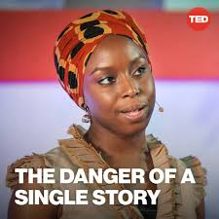
Tzu chi English Educational
Speaking
Being able to express your opinion
Listening
Active Listening with understanding
Creativity
Adding new thoughts to the discussion
Questions
Team Building
Asking poignant questions
Skills Fostered in this Class
Appropriate engagement
principles
What is an authentic story?
When on the ground, have you felt surprise?
Have you bought into a single story?
Power structures of the world
Start with the SECOND (what came second)
Create a word bank for discussion
When we reject a single story, we regain a kind of paradise
Nkali (back)
How told
When told
How often
A balance of stories matters
Representative
Holding onto a single story of a place, comes from literature (the internet/ news/ an event/ literature)
Christopher Bauman – www.chrisbauman.com.au

Slide 2
1. How impressionable and vulnerable we are in the face of a story ___________________________________________________________________________________________?
Advanced Question Words
2. Books have to be about… ___________________________________________________________________________________________ ?
Incomplete stories
misconceptions
3. I went though a mental shift ___________________________________________________________________________________________ ?
Overwhelmed with shame
4. The unintended consequence of not telling your story ___________________________________________________________________________________________ ?
Stereotypes
Patronizing
resilience
Get more than one story of a place
5. All I had heard was (poor), so it was impossible for me to see (place / people) as anything else but (poor) ___________________________________________________________________________________________ ?
Nurse ambition
6. (people) sometimes pass judgement prior to meeting someone ___________________________________________________________________________________________ ?
Power
7. Showing a people as one thing over and over again ________________________________________________________________________________________ ?
Flattern one’s experience
A balance of stories
8. To be greater than another ___________________________________________________________________________________________ ?
Single stories rob people of dignity
Jam disappears off the table?
https://youtu.be/D9Ihs241zeg
Christopher Bauman – www.chrisbauman.com.au

